Slide 1

SMART PHONE DATA ANALYSIS
Sindhu Namani

Slide 2
INTRODUCTION
Dataset chosen is a collection of smartphone models extracted from SmartPriks sites like Beautiful Soup.
The dataset includes smart phone features like customer’s rating, prices, battery and memory etc.
Used R programing for analyzing the data, identify patterns and trends.
Agenda is to understand the preference of customers in features and price range.

Slide 3

DATASET EXPLANATION
The dataset contains 1020 entries and 11 columns.
Model
Sim
Price
Display
Camera
Card
Rating
OS
Processor
RAM
Battery

Slide 4
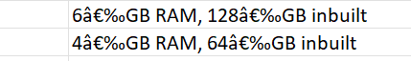
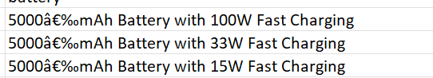
DATA CLEANING PROCESS
Category | Before cleaning | After Cleaning
Price | “â‚¹54,999” | 54,999
Ram and storage | Both the categories were in the same field like | Separated ram capacity and internal memory into two columns.
Battery data | Battery percentage and fast charging were in the same field | Converted the battery into 3 columns, “Battery capacity”, “fast charging availability” and “fast charging capacity
Display Details | Extract display size, resolution, and refresh rate into separate columns. Ensure consistent formats (e.g., numeric values, standardized resolution format). | Separate columns: display_size (in inches) display_resolution (e.g., "1080x2400") refresh_rate (in Hz).

Slide 5
DATA CLEANING PROCESS
Category | Before cleaning | After Cleaning
Brand Names | Parse the model column to extract the brand_name. Standardize brand names (e.g., "Samsung" instead of "samsung"). | New column brand_name (e.g., "Samsung", "Apple", "OnePlus").
Extended Memory Availability | Add a binary column extended_memory (1 = Yes, 0 = No). Extract the memory limit into a column memory_limit (e.g., "512 GB"). | New columns: extended_memory (e.g., 1 or 0) memory_limit (e.g., "512 GB" or "No Limit").

Slide 6
DESCRIPTIVE STATISTICS
Variable | Minimum | 1st Quartile | Mean | Median | 3rd Quartile | Maximum
price | 6699 | 12999 | 18526 | 15999 | 19999 | 23999
rating | 60.00 | 75.00 | 78.06 | 79.00 | 82.00 | 89.00
Num cores | 4.000 | 8.000 | 7.955 | 8.000 | 8.000 | 8.000
Processor speed | 1.600 | 2.000 | 2.217 | 2.200 | 2.400 | 3.200
Battery capacity | 3100 | 5000 | 5069 | 5000 | 5000 | 22000
ram | 2.000 | 4.000 | 5.926 | 6.000 | 8.000 | 12.000
Screen size | 5.900 | 6.500 | 6.560 | 6.680 | 6.662 | 6.950
Rear camera | 8.00 | 48.00 | 55.19 | 50.00 | 64.00 | 200.00
Front camera | 5.00 | 8.00 | 14.96 | 16.00 | 16.00 | 60.00
Refresh rate | 60.0 | 60.0 | 88.4 | 90.0 | 120.0 | 144.0
Extended upto | 128.0 | 512.0 | 797.5 | 1024.0 | 1024.0 | 2048.0

Slide 7
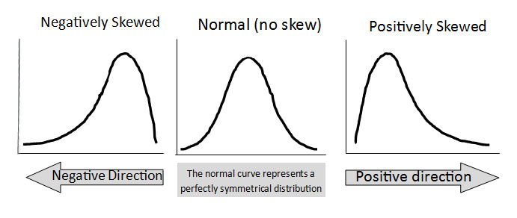
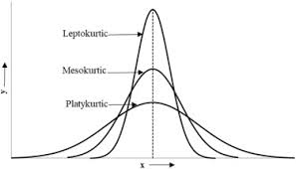
SKEWNESS AND KURTOSIS
Num of cores:
Skewness: -9.220168, indicates highly left-skewed distribution.
Kurtosis: 86.01149, suggesting leptokurtic distribution
Rating
Skewness: -0.7124205, indicates slightly left-skewed distribution
Kurtosis: 3.503016, suggesting leptokurtic distribution
Price
Skewness: 10.29812, Indicates highly Right skewed distribution
Kurtosis: 146.351, suggesting highly leptokurtic distribution
Battery capacity
Skewness: 12.94512, indicates highly right skewed
Kurtosis: 213.4553, it is leptokurtic distribution

Slide 8
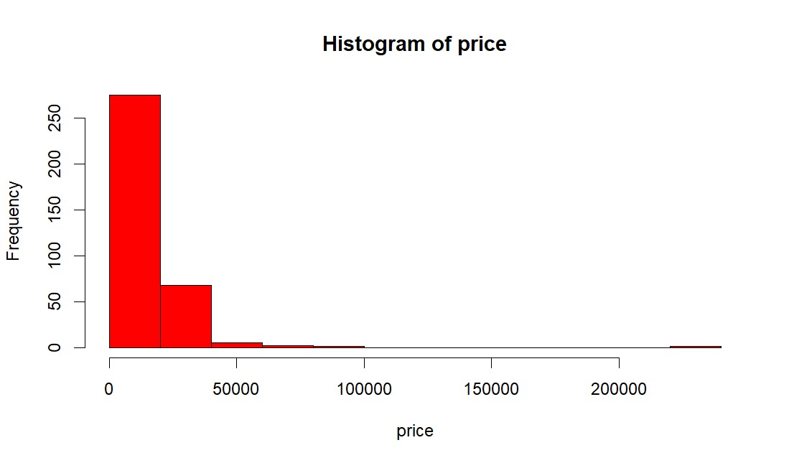
HANDLING OUTLIERS
Outliers were identified in the price variable
Adjusted by replacing them with the mean value of the ‘price’ variable.
Effectively managed, ensuring a more reliable dataset for further analysis.

Slide 9
HYPOTHESIS TESTING
Objective:The main objective is to determine and check that is there any significant correlation between the price of the smartphones and its user ratings.
Null Hypothesis (H₀): There is no significant correlation between the price of a smartphone and the user rating(correlation=0).
Alternative Hypothesis (H₁): There is a significant correlation between the price of smartphones and the user ratings(correlation>0).

Slide 10
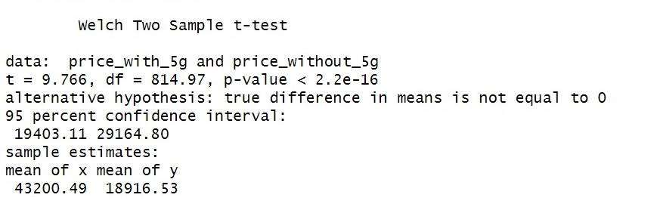
RESULTS OF HYPOTHESIS
T-statistics: 9.766
Degrees of freedom:814.97
P-value: <0.0001, with 5% significance level-indicates a statistically significant difference.
Conclusion: Reject Null hypothesis; There is a significant differences .

Slide 11
ONE WAY ANOVA AND RESULTS
F-value = 24.87, P-value = <2e – 16
Interpretation: Here p value is small where F value is large, so we concluded that they are statistically different between prices and various processor brands.
Conclusion :
The results of the one-way ANOVA is statistically differences in smartphones costs on various processor brands.
Outcomes :
Smartphones prices differ by processor brands
It is useful for both businesses and buyers to make decisions easier.

Slide 12
TWO WAY ANOVA TEST AND RESULTS
Processor Brand
F-value = 25.894 , P-value = <2e-16
5-G
F-value = 27.237 , P-value= 2.22e-07
Conclusion:
Different processor brands affects the prices
Phones with 5G capability costs more and less cost depends upon the capabilities.
Outcomes:
Processor and 5G mobiles costs more.
Prices may differ with 5G and without 5G.

Slide 13
CHI-SQUARED TEST
Association between has 5G capability and has NFC Capability.
Chi Square value (X-Squared) – 9.2184
It has Degrees of freedom (df) is - 1
value of p is 0.002396
Conclusion:
We reject the Null hypothesis(H0) while value of p is extremely small, so there is significantly association between smartphones having 5G capability and having NFC capability.

Slide 14
TWO WAY CHI-SQUARED TEST
Association between 5G and processor brand
Chi Square value – 174.77
Degrees of freedom (df) -6
P value : < 2.2e-16
Conclusion:
Rejecting the null hypothesis (H0) because the value of p is extremely small which means there is a significant association between 5G and processor brands.

Slide 15
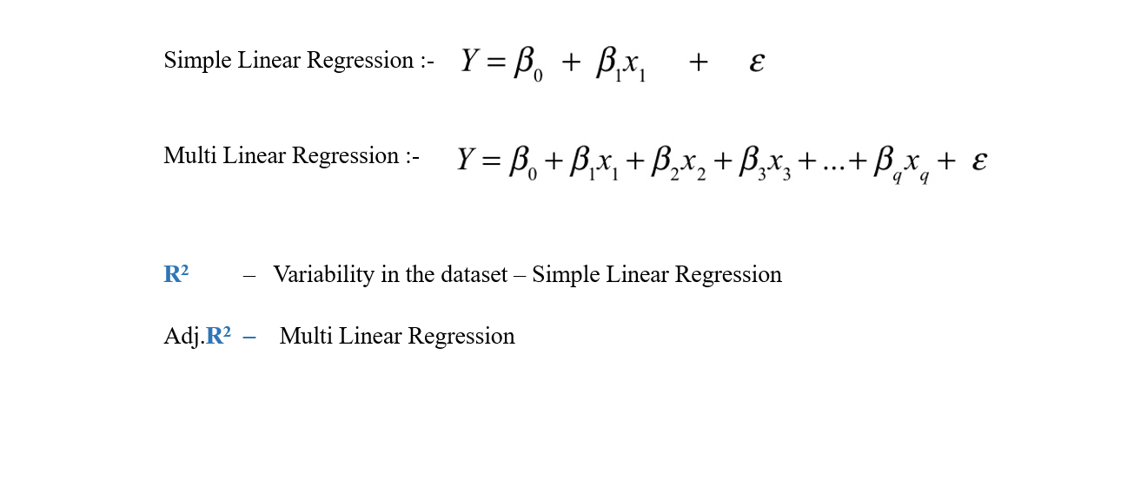
LINEAR REGRESSION

Slide 16
LINEAR REGRESSION-Predicting Price based on screen size and has 5g
Price= β0 + β1 . brand+ β2 . battery + β3 . Fast charging+ β4 . has nfc+ β5 . Ram capacity + ϵ
R-square: 0.09500919
Adjusted R-square: 0.0931566
The variables explain -9.31 of variance in price
Some predictors significantly influence price.

Slide 17
CONCLUSION
Dataset: The analysis used data of 1020 mobile phones, examining various factors price, has_5g, has_nfc, battery_capacity, screen_size, ram_capacity.
Key findings:
Price variation: The price of the smart phones differ based on the brand of the processor used.
Cost effective: Smartphones with 5g network are more costlier than the phones without 5g.

Slide 18
Actions needed:
Focus on Affordability and Value
Observation: A wide price range suggests a market demand for both budget and premium smartphones.
Action:
Expand mid-range smartphone offerings with competitive features like 5G, high refresh rates, and good cameras.
Offer feature-rich entry-level models for emerging markets to capture a broader audience.
Expandable Memory for Budget Phones
Observation: Some phones offer expandable memory, but it is not universal.
Action:
Include expandable memory options in entry-level and mid-range models to cater to users in regions where cloud storage is less prevalent.

Slide 19
Analyze Consumer Feedback
Observation: Ratings in the dataset range from 75% to 89%, leaving room for improvement.
Action:
Actively gather and analyze feedback from lower-rated models.
Address specific pain points such as UI experience, bloatware, or durability.
By focusing on these areas, smartphone companies can better align their product offerings with consumer expectations and market trends

Slide 20
THANK YOU

